Slide 1
Predictive Analytics for Hospital Bed Occupancy Management
Name: Ali abdelmeneam abdel karim
Id: 21510563
Dr. Amira Abdo

Slide 2
1- introduction 2-problem statement 3-objectives 4-Literature review 5-Proposed solution 6-

Slide 3
Introduction
• Hospitals face challenges in managing bed occupancy due to unpredictable admissions.
• Overcrowding leads to delays and stress on healthcare workers.
• Predictive analytics can optimize resources and improve patient care.

Slide 4
Problem Statement
• Overcrowding increases wait times and reduces care quality.
• Underutilization wastes resources and impacts financial stability.
• A predictive system is needed to forecast trends and improve planning.

Slide 5
Objectives
1. Develop a machine learning-based predictive model.
2. Create a web-based dashboard for hospital administrators.
3. Optimize resource allocation to improve patient outcomes.

Slide 6

Literature Review (Part 1)
• Existing methods include statistical models and manual planning.
• Challenges include limited accuracy and adaptability.
• Machine learning offers a more robust solution.

Slide 7
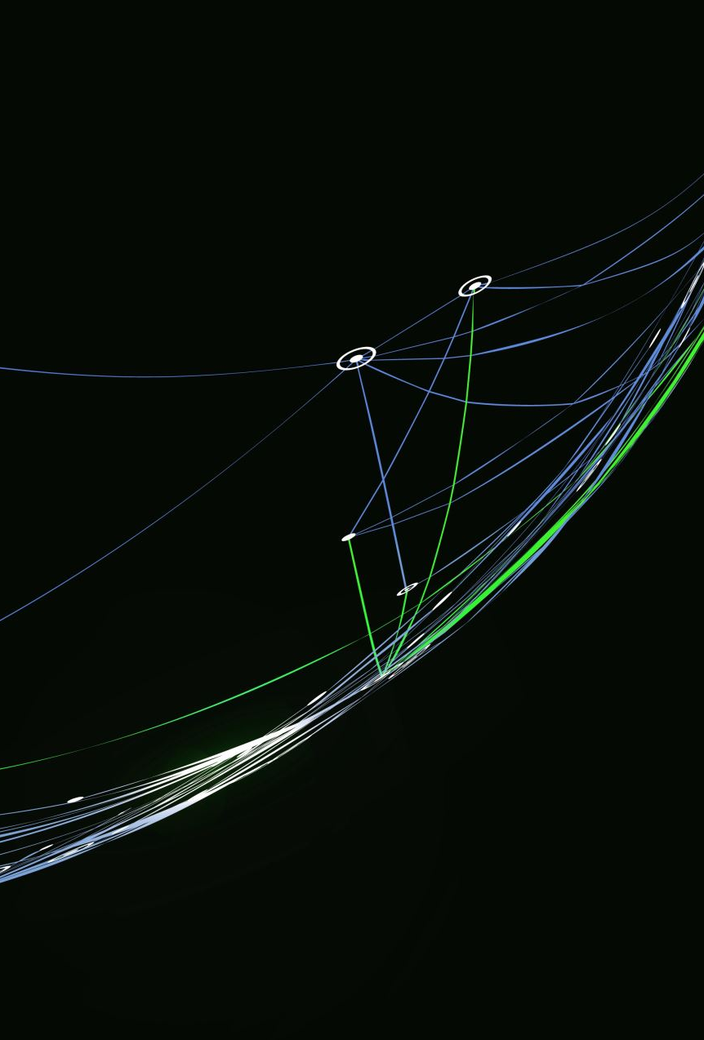
Literature Review (Part 2)
• ML techniques like random forests and neural networks are effective.
• Challenges include usability and integration with workflows.
• This project bridges the gap with a user-friendly dashboard.

Slide 8

Proposed Solution
• Components:
- Data Collection and Preprocessing Module.
- Predictive Machine Learning Model.
- Streamlit-based Web Dashboard.

Slide 9

Methodology
1. Planning and Setup.
2. Data Collection and Preparation.
3. Model Training and Testing.
4. Dashboard Development and Deployment.

Slide 10
System Workflow
1. Input data into the system.
2. Validate and preprocess the data.
3. Train the model or use a pre-trained model.
4. Generate predictions and visualizations.

Slide 11

Expected Outcomes
• Improved hospital resource allocation.
• Reduced patient wait times and operational costs.
• Enhanced decision-making through predictive insights.

Slide 12
Challenges and Limitations
• Data privacy and availability.
• Ensuring model accuracy and reliability.
• Adoption by non-technical users.

Slide 13

Conclusion
• Predictive analytics improves hospital operations.
• This project bridges the gap between advanced tools and practical needs.
• Thank you!

